Slide 1

Solar Power Prediction PROJECT
Predicting Solar Energy
Production Using
Machine Learning Methods
Notes:
Image source: Microsoft 365 content library Background images for a solar power prediction project often feature solar panels under sunlight, clear skies, and graphs or data overlays representing energy output. These visuals help convey the project's focus on renewable energy and data analysis. Effective imagery enhances understanding and engagement in presentations.

Slide 2
Group Number 6
Team Member’s
DHEERAJ
ISHITA
KAMINI
MIHIR
PRANEETHA
RENUKA
SHRADDHA

Slide 3
PROBLEM DEFINITION
The primary goal of this project is to model solar energy
To develop a machine learning model that accurately predicts solar power generation based on historical solar panel output and meteorological data
Aim is to minimize prediction errors (RMSE/MAE) and maximize operational efficiency for grid management

Slide 4

Weekly Project PLAN Timeline
SNo | Descriprtion
Week1 | Scope and Business Statement
Week2 | Data Understanding and Preprocessing (EDA)
Week3 | Model Building and selecting the Best Model
Week4 | Deployment of the application in Streamlit
Week5 | Final Presentation
Tracking Progress
A weekly timeline allows for continuous monitoring of project progress, helping identify delays early and keep the project on target.
Setting Milestones and Deadlines
Clear milestones and deadlines for each task ensure the project advances in a timely and organized manner.
Weekly Review Meetings
Regular reviews foster accountability, allow for quick adjustments, and help the team maintain focus and momentum.
Notes:
Image source: Microsoft 365 content library A weekly project timeline helps track progress and set clear milestones. Tasks are assigned and deadlines are established to ensure each phase is completed on schedule. Regular weekly reviews facilitate adjustments, improve accountability, and help the team maintain momentum toward achieving project goals.

Slide 5
BUSINESS OBJECTIVES
1 | Optimizing Energy Storage Management By predicting future solar generation and demand peaks, the model helps reducing energy waste
2 | Reducing Operational Costs: The model optimizes operating costs by helping to determine the appropriate amount of solar energy
3 | Accuracy Improvement Surpass conventional forecasting techniques

Slide 6
DATA UNDERSTANDING
Data Description & Source
solarpowergeneration
(2) (1).csv
Features
distance-to-solar-noon temperature wind-direction wind-speed sky-cover visibility humidity average-wind-speed-(period) average-pressure-(period)
Target variable: power-generated:

Slide 7
DATA CLEANING AND PRE PREPROCESSING
Handled missing values
Data Standardized
Dataset validated for duplicate Records
Replacing the identified values with the chosen central tendency measure
Outliers Treatment
Identified through Box plots and treated through IQR method

Slide 8

Visualizing Data Effectively(EDA)
Using Histograms for Frequency
Histograms are incorporated for displaying the frequency of data within intervals, revealing underlying distributions and trends.
Bar Graphs for Comparison
Bar graphs have been visualized to compare categories side by side
Scatter Plots
Visualizations showing relationships (scatter plots) between variables included
Correlation Matrix:Correlation coefficients between multiple variables, indicating the strength and direction of their linear relationships, included
Notes:
Image source: Microsoft 365 content library Histograms and bar graphs help illustrate data trends and distributions clearly. Histograms are ideal for showing frequency of data within intervals, while bar graphs compare categories side by side. Including these visuals in your slide enhances understanding, highlights key differences, and makes complex information easier to interpret for your audience.

Slide 9
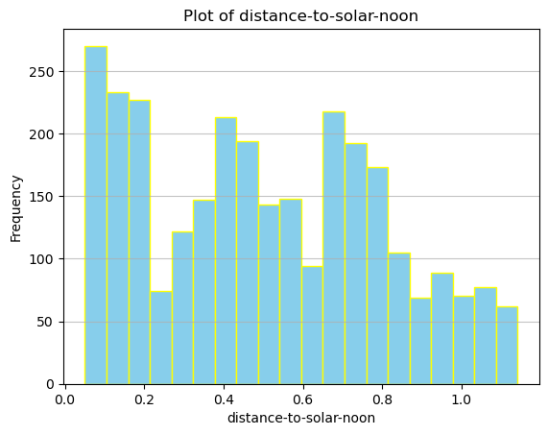
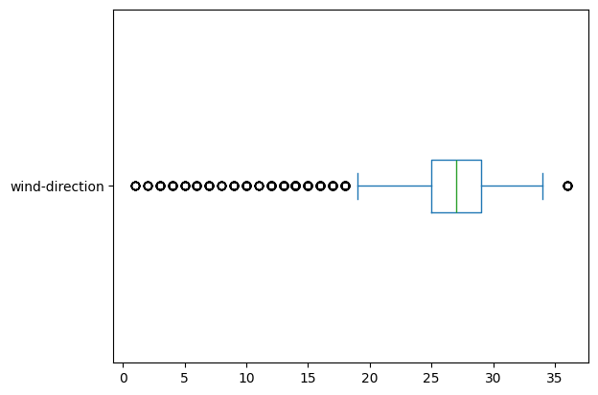
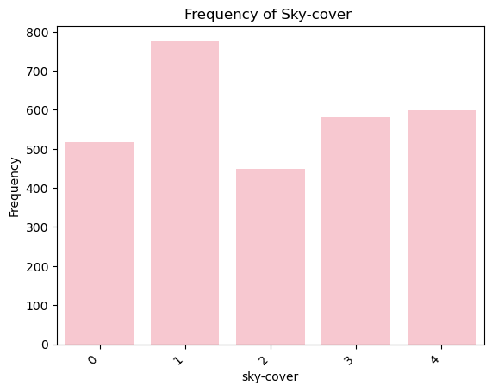
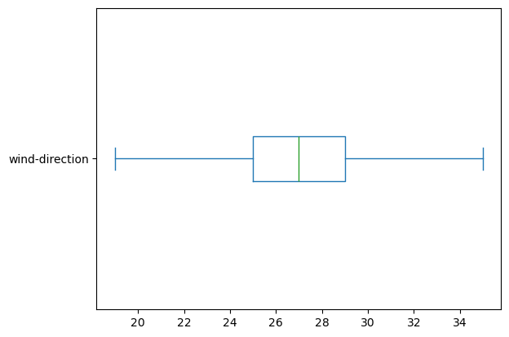
SAMPLE Visualization
Visualizations showing relationships (scatter plots) between variables done
Distributions (histograms) between features and the target variable
Bar graph
Correlation Matrix

Slide 10
MODEL DEVELOPMENT
01 | Multiple Linear Regression
02 | Multiple Linear Regression with Feature Engineering
03 | Random Forest
04 | Gradient Boosting
05 | PCA

Slide 11
RMSE and R2 METRICS COMPARISON
Sno# | MODEL NAME | RMSE |  | R2
 |  | TEST | TRAIN | TEST | TRAIN
1 | Multiple Linear Regression | 6075.394923889811 | 6095.950194009487 | 0.6527447554285812 | 0.6496260800298472
2 | Multiple Linear Regression With selected features | 6081.035007994409 | 6100.978591789999 | 0.6520992694607296 | 0.6490439447702768
3 | Random Forest | 1155.685399456077 | 3168.4818329283994 | 0.987432986492373 | 0.9047780227374073
4 | Gradient Boosting | 2397.001183747383 | 3072.0420802777744 | 0.945906072179967 | 0.9105778685336816

Slide 12
Results and Evaluation
4 different models built
Multiple regression with feature engineering(remove weak correlated variables done)
Note: But the metrics remain the same
Random forest shows slight overfitting (train performance >> test), but cross-validation scores remain strong, so it generalizes well.
Gradient Boosting is taken as best model
MODEL SELECTION

Slide 13
Results and Evaluation ADDITIONAL EXPERIMENTS
FEATURE ENGINEERING
Combining wind-speed and avg wind-speed And drop wind-speed and average-wind-speed-(period)columns with the new combined feature
RESULT: the metrics remain same
R-squared (R2) on Test Set: 0.63
R-squared (R2) on Training Set: 0.66
2. LINEAR REGRESSION WITH PCA
ELBOW Plot generated
Inferred that retaining 4 components may be suitable
Linear Regression (PCA) Mean Squared Error on Test Set: 45119322.88
Linear Regression (PCA) R-squared on Test Set: 0.57
Linear Regression (PCA) R-squared on Training Set: 0.61

Slide 14
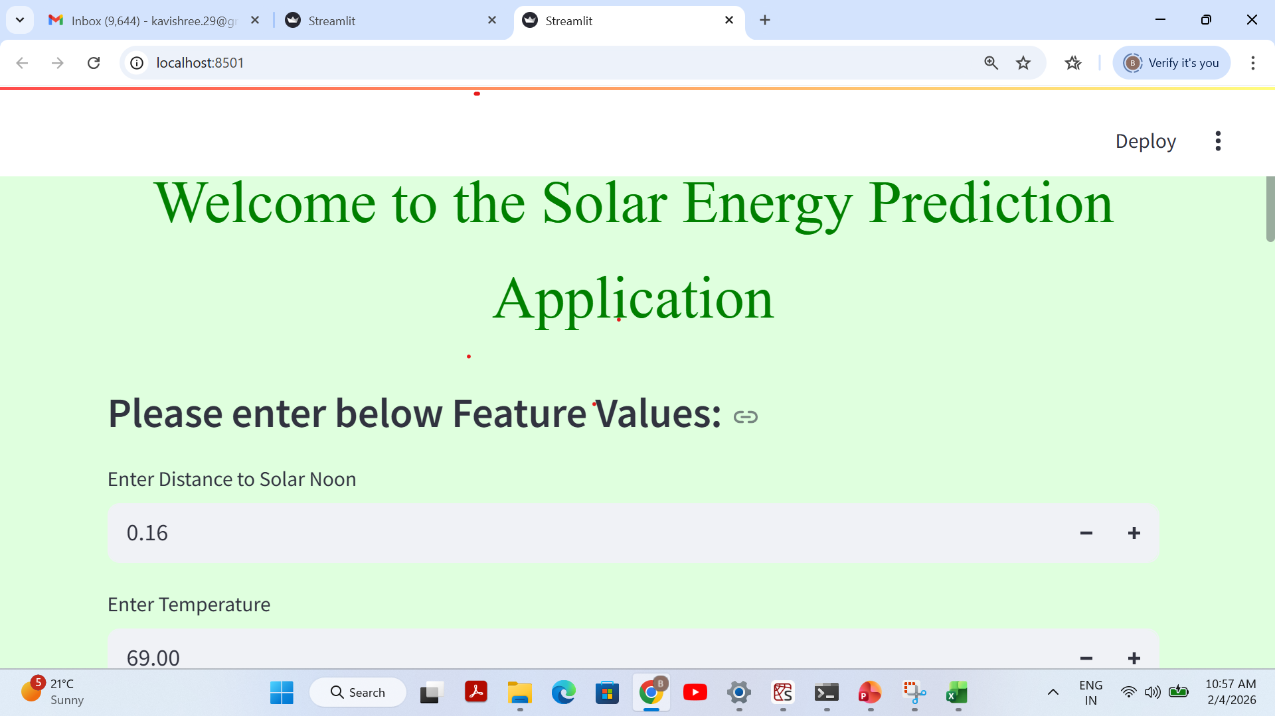
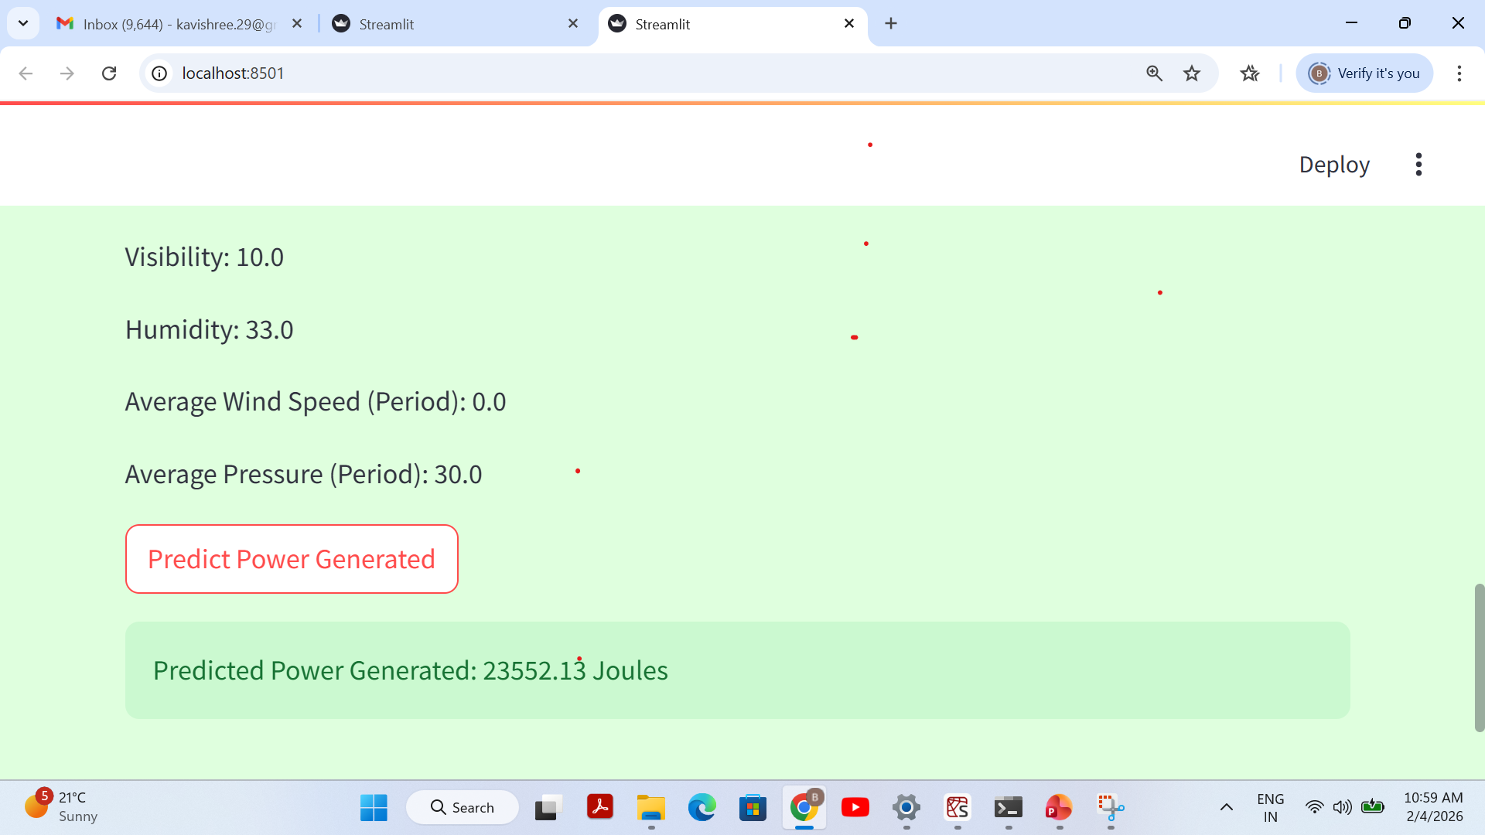
DEPLOYMENT:Streamlit Output

Slide 15
KEY INSIGHTS & CONCLUSION
By analyzing the 2920-sample solar powergeneration dataset, a Gradient Boosting Regressor was developed to predict power generated outperforming linear models.
The most significant drivers were distance-to-solar-noon and humidity.
We can conclude that the Gradient Boosting Model performs significantly better than the Linear Regression Model for this dataset. Its higher R2 scores on both the training and test sets indicate that it explains a much larger proportion of the variance in power-generated, making it a more accurate predictive model for this specific task.
The final model achieved an R2 of
Test R2=.90
Training R2=.95

Slide 16
FUTURE SCOPE
Dataset Enhancement
If available, incorporating additional meteorological data improve prediction accuracy.
Exploring Other Advanced Models
XGBoost, Light,GBM or even deep learning could potentially capture more complex patterns.
Strategic Planning and Growth
Long term prediction helps developers choose the best locations for new solar farms, maximizing energy production potential

Slide 17
Thank you

